Slide 1
INTERNSHIP 101
2015 Executive Board

Slide 2
Employers survey, 93% of the 266 surveyed employers plan to hire interns. In fact, those same employers are hiring 7% more interns than last year. (Forbes, 2011)
The opportunity to "test drive" a career (Would I be happier in marketing or advertising? (CNN, 2010)
Let’s face it, the job market is beyond competitive for incoming young professionals, and having a competitive edge is crucial. (PR Daily, 2013)

Slide 3
Resumes
4 C’s: Clear, Complete, Correct, and Concise
-You can elaborate about things in your cover letter, LinkedIn page, or portfolio (online or hard copy)
Talk about what you changed at each job, internship, or volunteer experience. Numbers are good to use.
Examples: I raised social media awareness by 40%
Increased likes on Facebook page from 200 to 450.
Get creative!
Use appropriate amount of color, different formatting, and graphics. Use your resume to show more about you.
-InDesign is a great tool to enhance your resume. Or Pintrest to find ideas.
DO NOT PROVIDE PHANTOM EXPERIENCE!
Employers will know whether your info in correct either by people or your knowledge on certain skills/ topics.

Slide 4
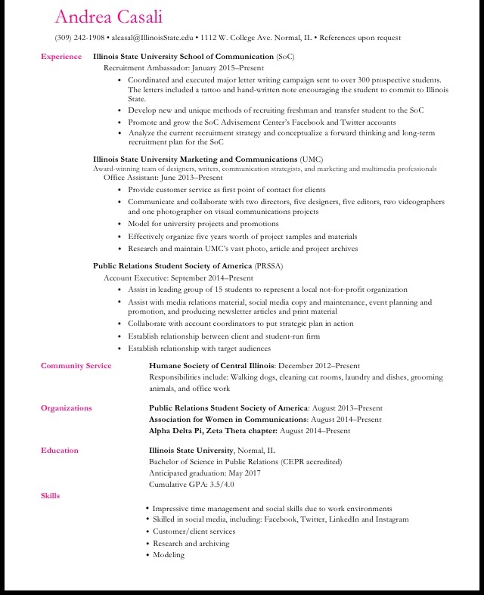

Slide 6
Cover Letter
Do not simply ask what you can gain from this employer, but what you can contribute to them.
Important to research who your cover letter will be sent to.
-Refrain from putting “To whom it may concern.”
Your time to stand out
-You can explain something on your resume if you think it is important.
Formatting, specifically
Single-space your cover letter.
Leave a space between your heading (contact info) and greeting ("Dear...:").
Leave a space between each paragraph.
Leave at least three spaces between your complimentary close ("Sincerely,") and typed name.
Sign your name in ink between your complimentary close and typed name.

Slide 7
Interview
Dress appropriately- business casual always safe bet.
Handshake, smile, and confidence. If you don’t feel like you’re selling yourself, your interviewer won’t think so either.
Research company. You will be asked questions about the company
Make sure you answer each question with completeness. Not sure? ASK!
The classic what are your strengths and weaknesses question….recognize those things you feel you need to work on and quickly shift to actions you have taken to improve in this area. Specific examples can be helpful to illustrate your progress
Bring a few copies of your resume printed on resume paper, portfolio, and thank you letter.

Slide 8
Field Experiences in Professional Communication 398

